Slide 1
N-gram Language Modeling
Introduction to N-gram Language Models

Slide 2
Predicting words
Sentence: "The cat sat on the ______."
Prediction: "mat."
Sentence: "She decided to bake a chocolate ______."
Prediction: "cake."
Sentence: "After a long day at work, he enjoyed a nice cup of ______."
Possible Predictions:
"coffee."
"hot chocolate."
"water."

Slide 3
Language Models
Systems that can predict upcoming words
Can assign a probability to each potential next word
Can assign a probability to a whole sentence

Slide 4
probability to each potential next word
these words might be ranked in terms of likelihood based on common usage and context:
Sentence: "After a long day at work, he enjoyed a nice cup of ______."
"coffee." 0.60 (Most likely, as many people enjoy coffee after work.)
"hot chocolate." 0.25 (A popular choice, especially in colder weather.)
"water." 0.15 (A common beverage, but less likely in the context of a comforting drink after work.)
These probabilities are illustrative and would vary based on the specific context and the model used for prediction.

Slide 5
Why word prediction?
It's a helpful part of language tasks
Grammar or spell checking
Their are two midterms Their There are two midterms
Everything has improve Everything has improve improved
Speech recognition
Sentence: "I scream for ice cream."
Phonetic Twist: "I scream for I dream."

Slide 6
Why word prediction?
It's how large language models (LLMs) work!
LLMs are trained to predict words
LLMs generate text by predicting words
By predicting the next word over and over again

Slide 7
Language Modeling (LM) more formally
Goal: compute the probability of a sentence or sequence of words W:
P(W) = P(w₁,w₂,w₃,w₄,w₅…w_{n})
Related task: probability of an upcoming word:
P(w₅|w₁,w₂,w₃,w₄) or P(w_{n}|w₁,w₂…w_{n-1})
An LM computes either of these:
P(W) or P(w_{n}|w₁,w₂…w_{n-1})

Slide 8

How to estimate these probabilities
Could we just count and divide?
No! Too many possible sentences!
We’ll never see enough data for estimating these

Slide 9
How to compute P(W) or P(w_{n}|w₁, …w_{n-1})
How to compute the joint probability P(W):
P(The, cat, sat, on, the, mat)
Intuition: let’s rely on the Chain Rule of Probability

Slide 10
Reminder: The Chain Rule
Recall the definition of conditional probabilities
P(B|A) = P(A,B)/P(A) Rewriting: P(A,B) = P(A) P(B|A)
More variables:
P(A,B,C,D) = P(A) P(B|A) P(C|A,B) P(D|A,B,C)
The Chain Rule in General
P(x₁,x₂,x₃,…,x_{n}) = P(x₁)P(x₂|x₁)P(x₃|x₁,x₂)…P(x_{n}|x₁,…,x_{n-1})

Slide 11
The Chain Rule applied to compute joint probability of words in sentence
P(“The cat sat on the mat”) =
P(The) × P(cat|The) × P(sat|The cat) × P(on|The cat sat) × P(the|The cat sat on) × P(mat|The cat sat on the)

Slide 12
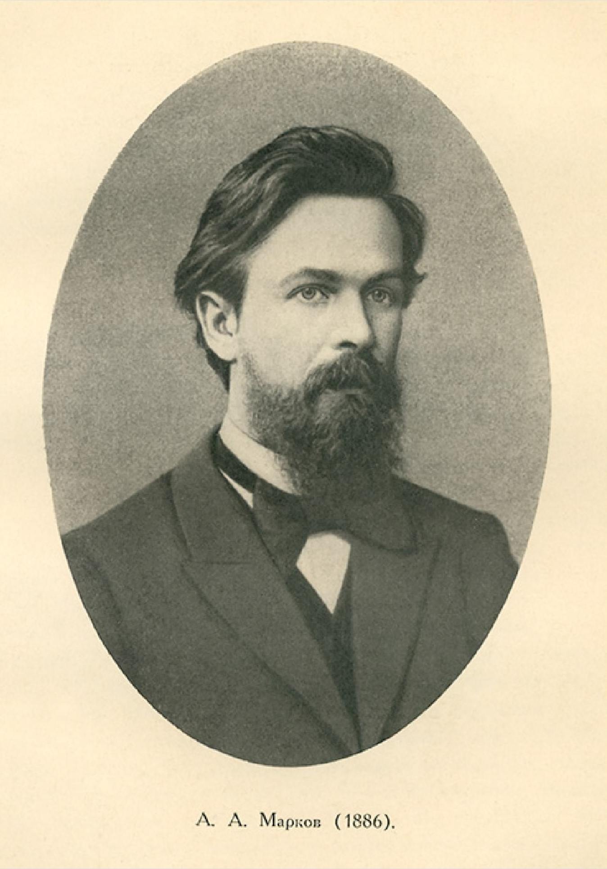
Markov Assumption
Simplifying assumption:
Andrei Markov
P(mat|The cat sat on the) ≈ P(mat|the)
Wikimedia commons

Slide 13
Bigram Markov Assumption
Instead of:

Slide 14
Bigram model
Some automatically generated sentences rom two different unigram models
Why dost stand forth thy canopy, forsooth; he is this palpable hit the King Henry. Live king. Follow.
What means, sir. I confess she? then all sorts, he is trim, captain.
Last December through the way to preserve the Hudson corporation N. B. E. C. Taylor would seem to complete the major central planners one gram point five percent of U. S. E. has already old M. X. corporation of living
on information such as more frequently fishing to keep her

Slide 15
Problems with N-gram models
N-grams can't handle long-distance dependencies:
“The soups that I made from that new cookbook I bought yesterday were amazingly delicious."
N-grams don't do well at modeling new sequences with similar meanings
The solution: Large language models
can handle much longer contexts
because of using embedding spaces, can model synonymy better, and generate better novel strings

Slide 16
Text Generation: The Wall Street Journal
Notes:
To get an idea of the dependence of a grammar on its training set, let’s look at an n-gram grammar trained on a completely different corpus: the Wall Street Journal (WSJ) newspaper. Shakespeare and the Wall Street Journal are both English, so we might expect some overlap between our n-grams. There is no overlap even in small phrases, let alone entire sentences. Statistical models are use- less as predictors when the training sets and the test sets are as different as Shakespeare and WSJ.

Slide 17


Questions ☺
Thanks … Grazie … شكرا … Gracias … Merci … 谢谢 (Xièxiè)

